Slide 2
Simplified least square equation : Ax = B
A : nt x nc
x : nc (x 1 for individual timeseries)
B : nt (x 1 for individual timeseries)
2D Optimization of UTide (i.e. SWOT, model or any set of timeseries sharing the same time axis) :
2D vectorized : do only one solve call for 2d-array B representing the horizontally stacked B's
Fully vectorized, theoretically the most efficient numerical approach
The matrix B can become very huge, memory issues on personal computers for large dataset (e.g. HR model)

Slide 3
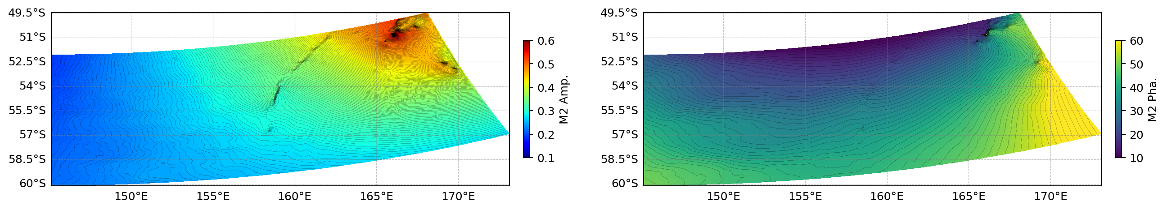
Use cases : Tidal Analysis
SHOC model elevation outputs
Application on SHOC hourly elevations, for a 3-month run (59070 grid points, 2184 timesteps)
8 constituents, no confidence interval
2D/Vectorized : 11 seconds
1D/Recursive : 2200 seconds (35 min)
8 constituents, with confidence interval
2D/Vectorized : 110 seconds
1D/Recursive : 2435 seconds (41 min)
CI calculation, based on residual PSD at tidal frequencies, is still 1D recursive in the 2D solver
Amplitude and phase of M2, computed on SHOC model in the ACC-SMST area

Slide 4
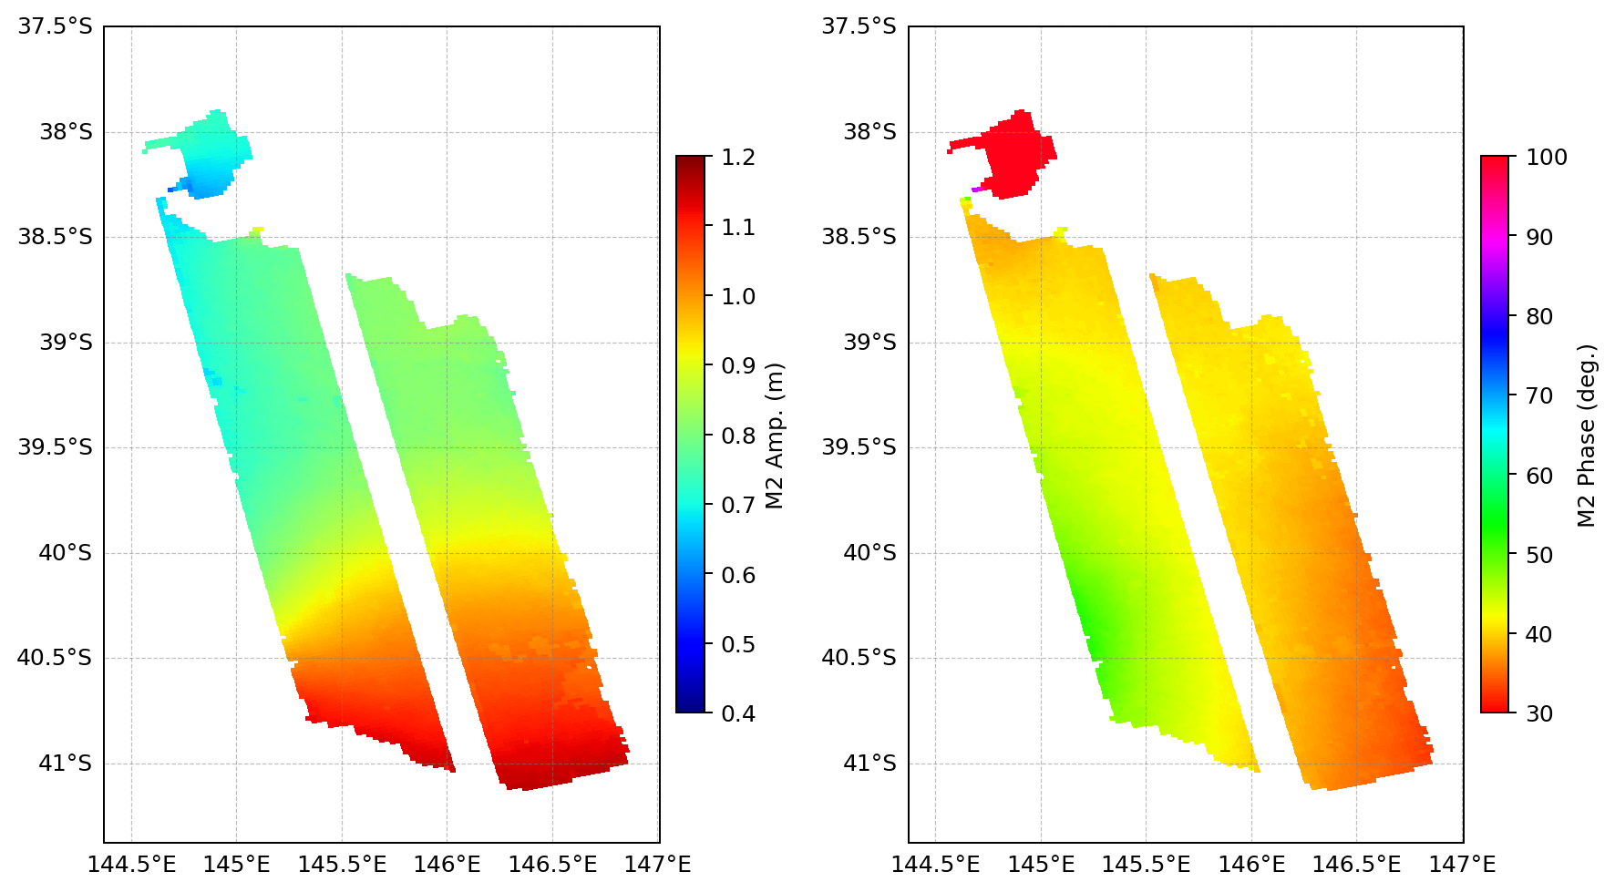
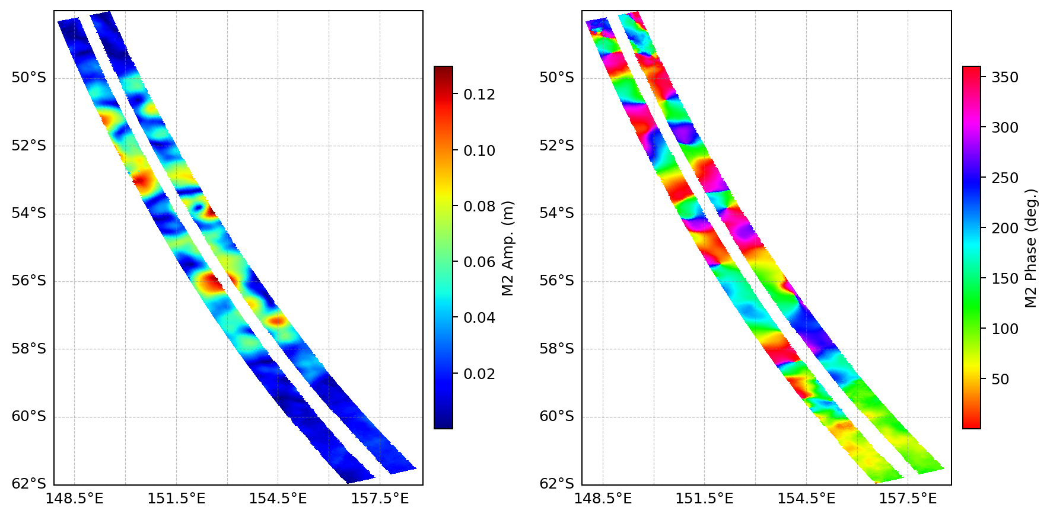
Use cases : Tidal Analysis
SWOT FSP track #006
Barotropic tide
SWOT FSP SSH (SSHA uncorrected from tides), in Bass Strait
(14145 grid points, 80 pass)
8 constituents, no confidence interval
2D/Vectorized : 0.14 seconds
1D/Recursive : 130 seconds
Internal tide
SWOT FSP SSHA (Corrected from FES2022 tides), in ACC-SMST
(55545 grid points, 80 pass)
8 constituents, no confidence interval
2D/Vectorized : 0.53 seconds
1D/Recursive : 440 seconds
Non-locked signal/eddies contamination
Phase locked M2 internal tide

Slide 5
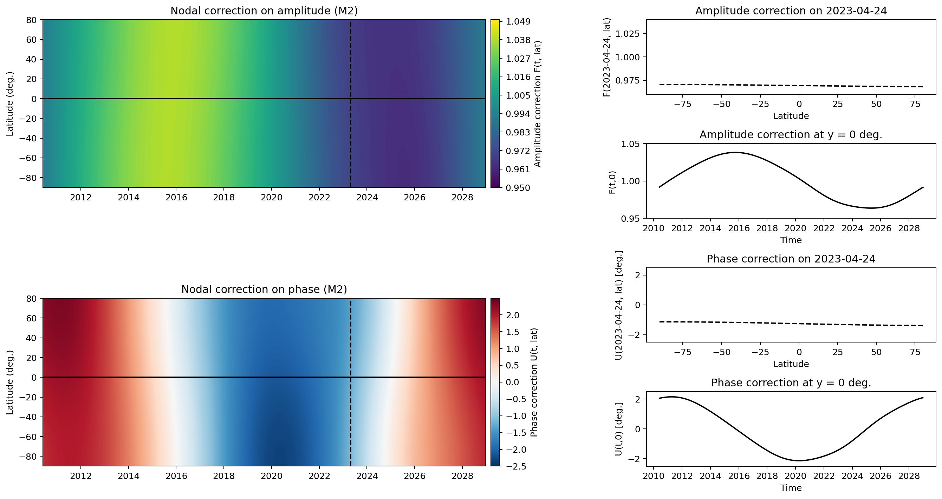

Slide 6
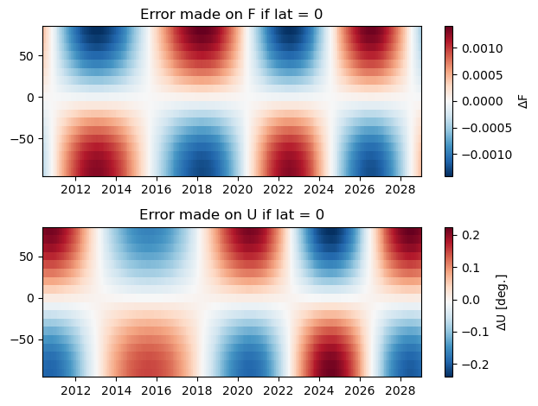
+/- 1 per thousand
→ 0.25 mm for M2 = 0.25 cm (SMST)
→ 1 mm for M2 = 1 m
→ 1 cm for M2 = 10 cm
+/- 0.2 deg
The nodal correction in mainly time-dependant
Omitting the latitudinal dependance have a negligeable impact at first order
→ time-dependant nodal factor only for 2D Utide Solver allows to include it in the LSQ fit without any computional cost (latitude is taken as the average of the inputs points)
→ The accurate solution would require to exclude the nodal correction from the fit, and compute it a posteriori for each input point, then correct the fitted amplitude/phase (costly but faiseable)

Slide 7
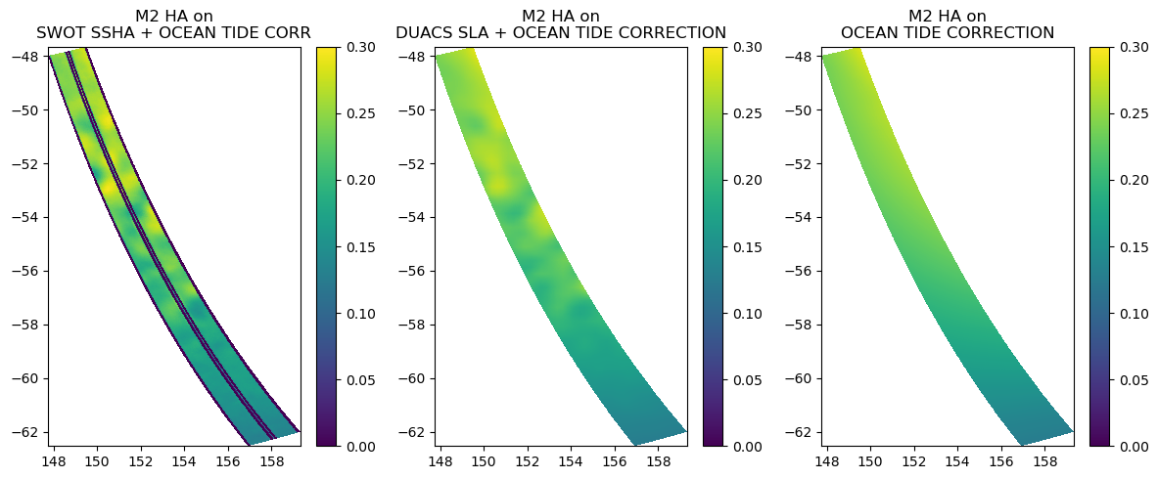

Slide 8
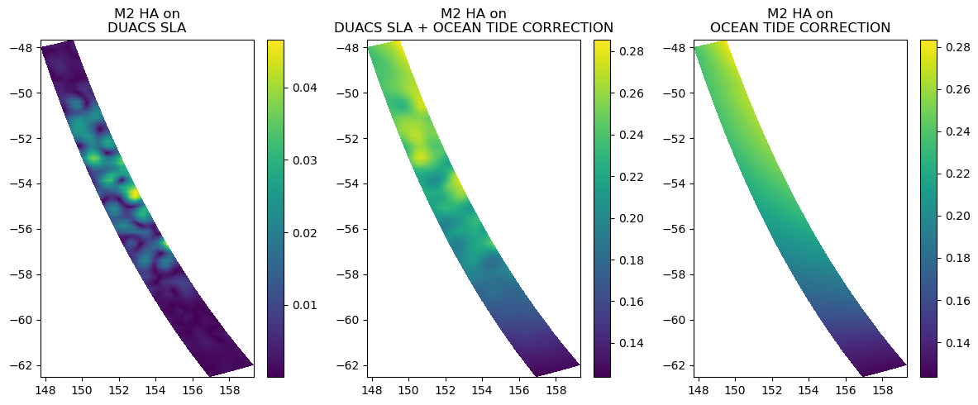

Slide 9
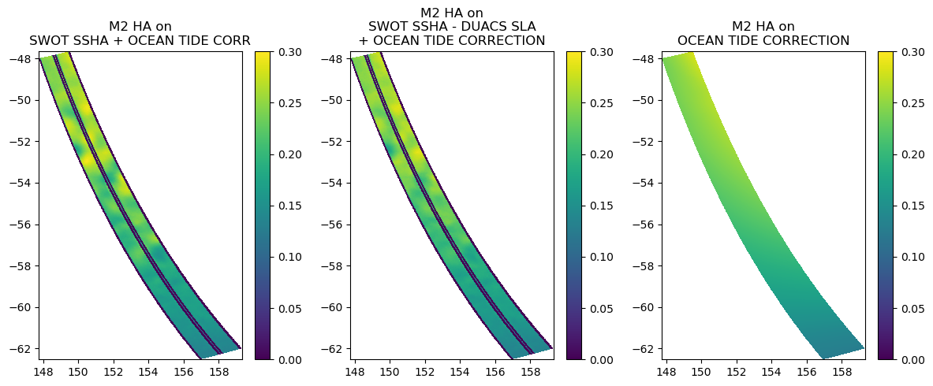

Slide 10
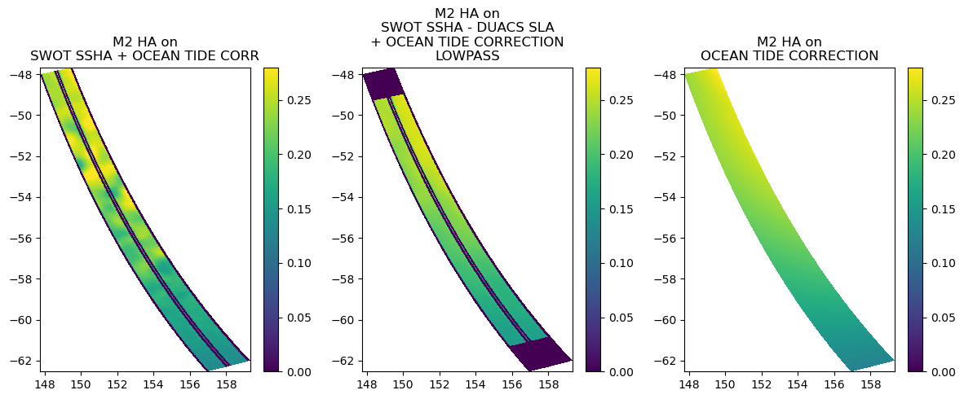

Slide 11
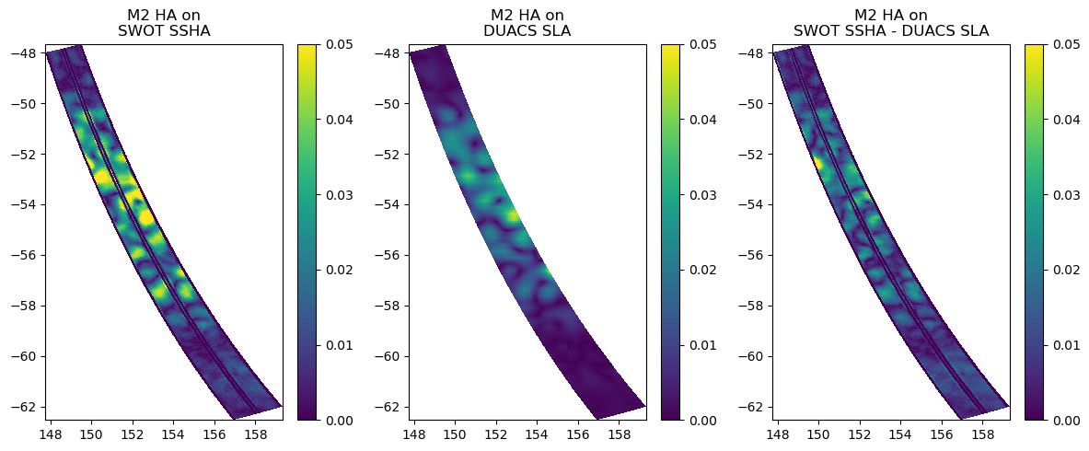

Slide 12
BRAN reanalysis and synthetic tide
SHOC regional model
Hydrodynamic model forced by Ocean Map (T, S and SLA) and tide at boundaries (GOT) (3 months)
How long does it take to converge with the M2 solution ?
What is the inprint of mesoscale/sub-mesoscale on M2 amplitude field when analysing shorter periods ?
Which spatial filtering allows to recover the M2 solution when analysing on shorter periods ?
Phase locked Internal tide : How to disantengle it from background oceanic field and recover it with HA ?

Slide 14
Roadmap
Confidence intervals
2D reconstruction
Inference
Nodal factors
Test/Benchmarking

